Slide 1

SyNERGY 2.0 Final Product
Ambur, Lacek

Slide 2
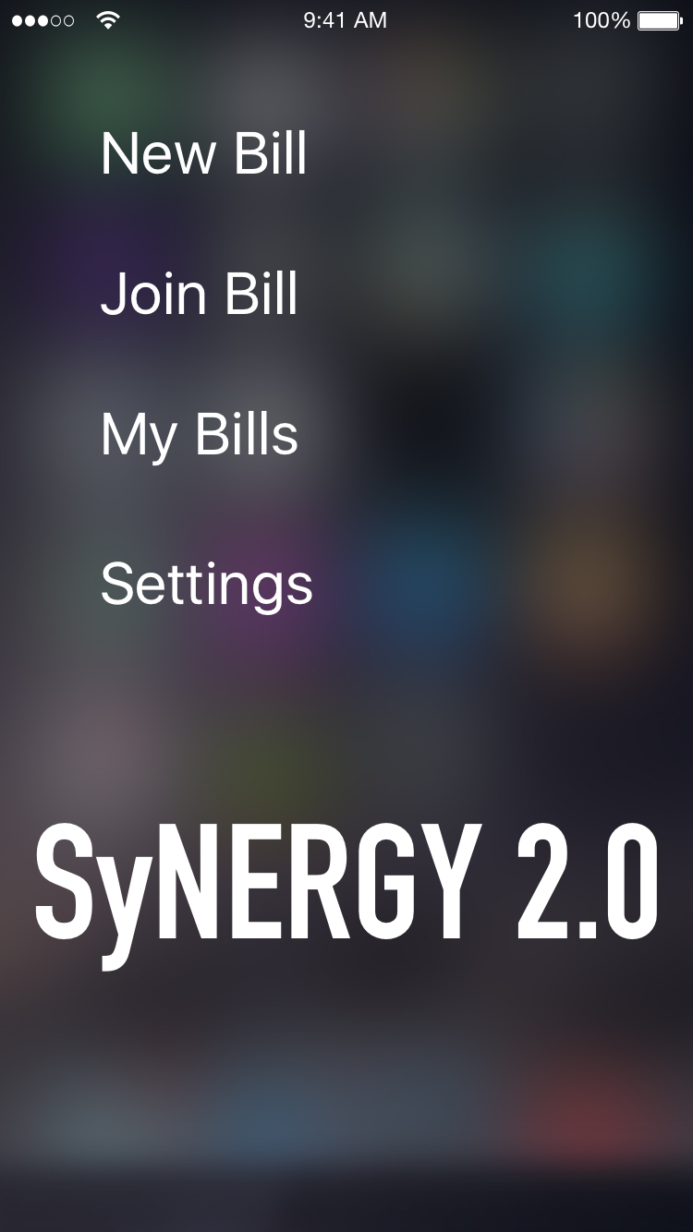
Overview
Mobile app that reduces frustrations and time of splitting bills with friends
Focused on ease of use for the user
Simple and clean UI design

Slide 3
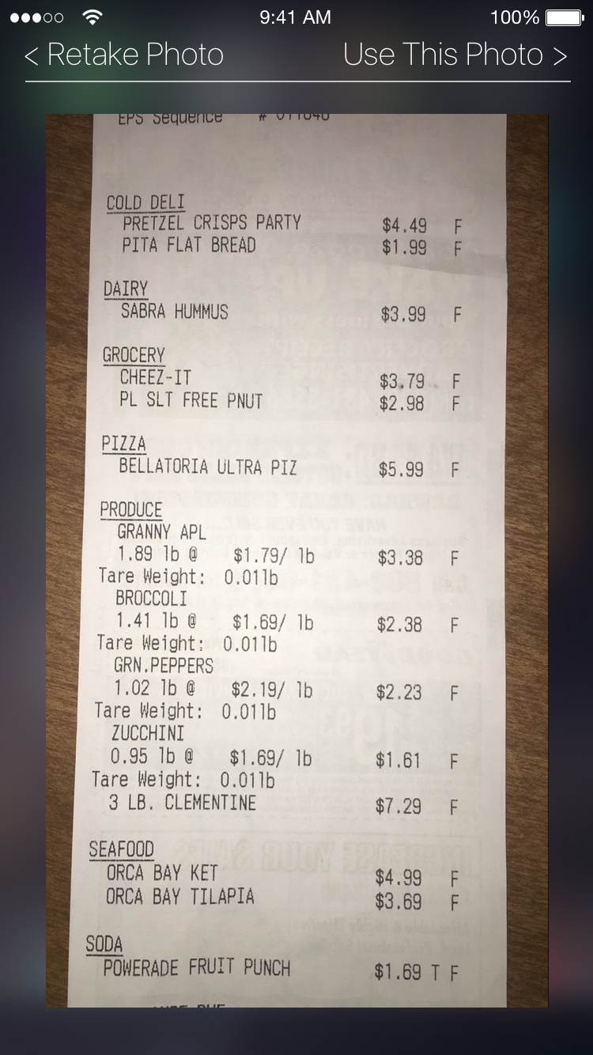
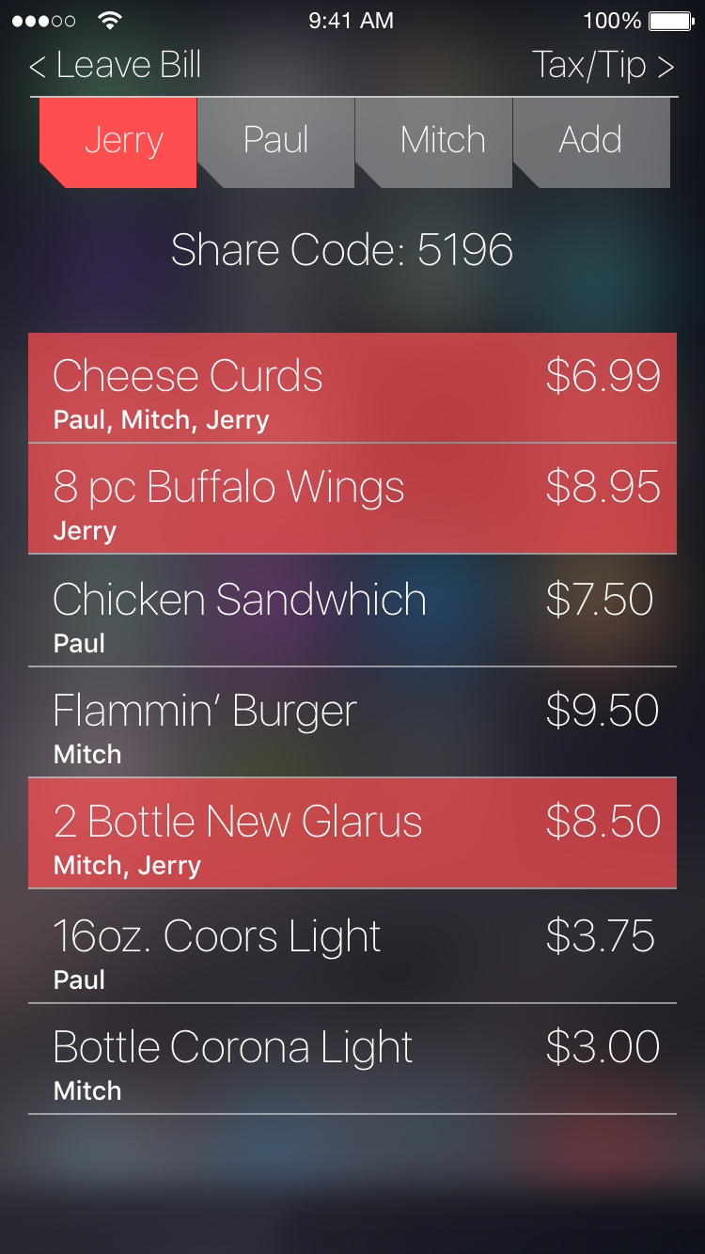
Selecting Purchased Items
Reading Receipt
Take picture of receipt
Splits receipt into selectable items
Bill Overview
Displays all items and prices from receipt
Select items each user purchased
Splits items between users by having multiple users select the same item

Slide 4
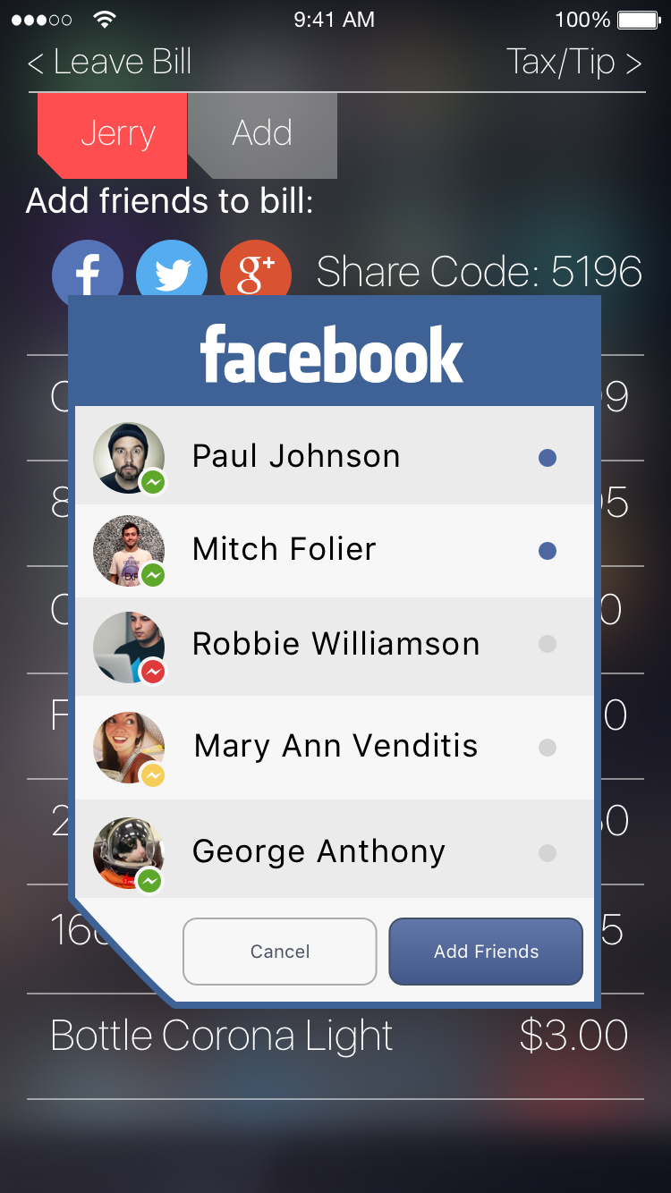
Inviting Friends to the Bill
Share Code
Simple 4 digit code
Easy and quick to share with friends around you
Social Network
Have to search through all friends
Takes longer for users to invite all friends

Slide 5
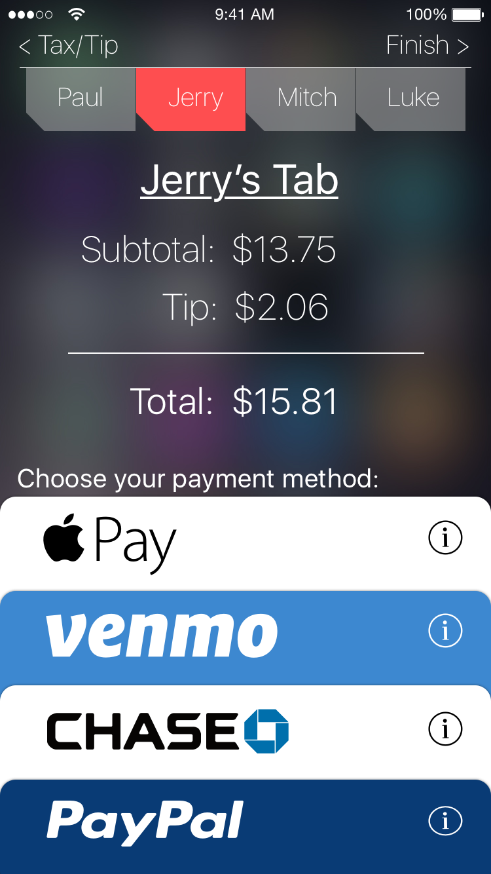
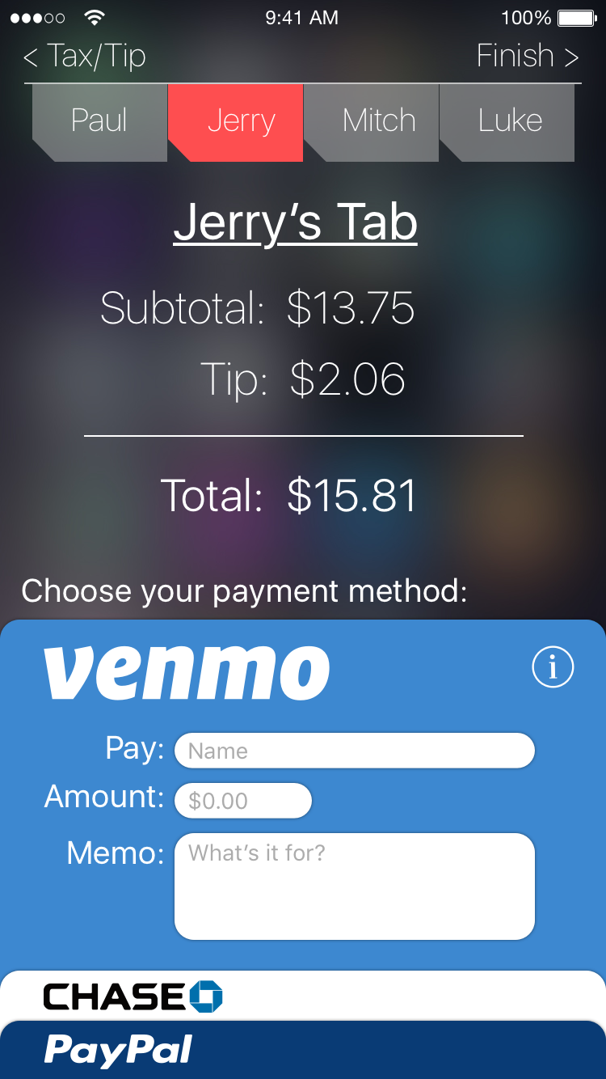
Payment Methods
Enabled payments between multiple different services
In app payments to other members of the bill
Reduce payment time and frustration

